Slide 1
Physiology of the eye
Practical lessons

Slide 2
Strucure of the eye
Adult eye ball is spherical about 1 inch in diameter & formed of
Outer fibrous layer
Middle vascular layer
Inner nervous layer
Eye lid, lacrimal glands, extraocular muscles.

Slide 3
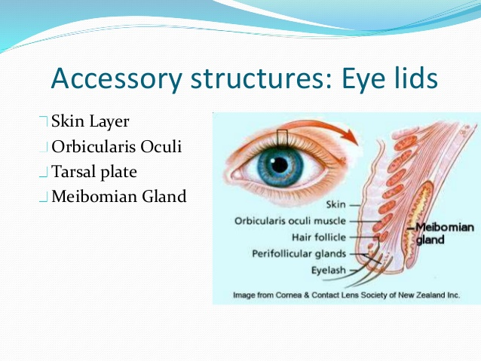

Slide 4
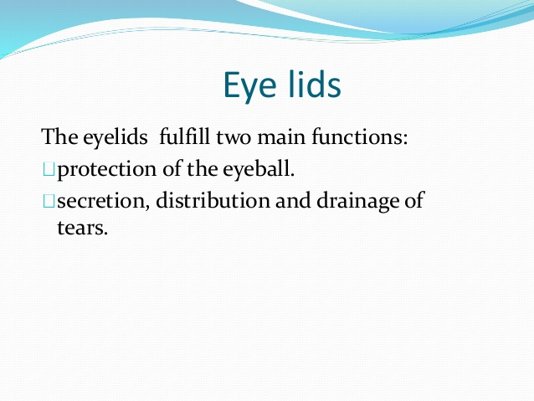

Slide 5
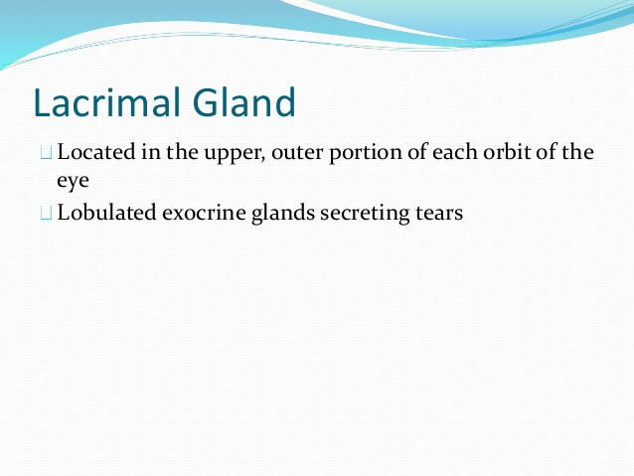

Slide 6
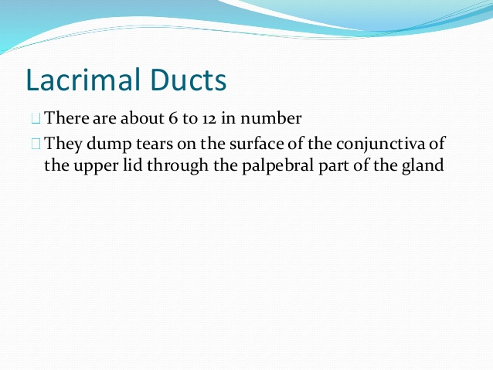

Slide 7
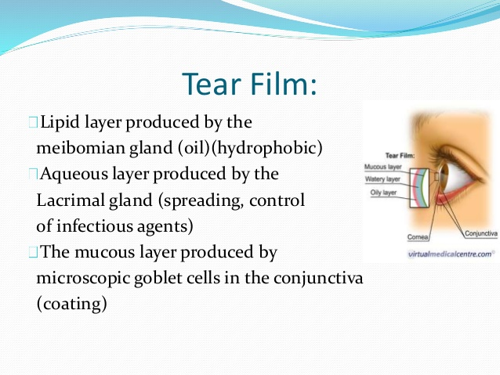

Slide 8
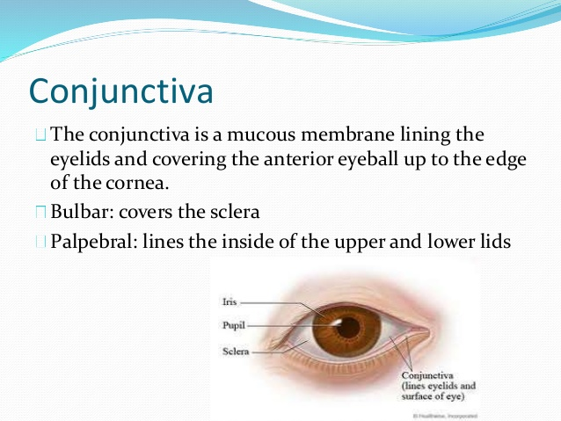

Slide 9
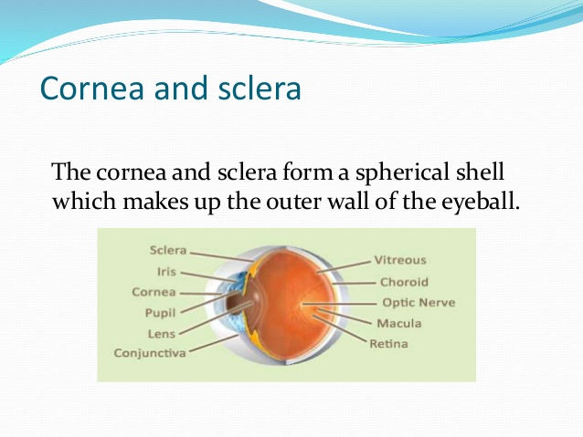

Slide 10
The cornea
The anterior 1\6 of outer layer.
0.5-1mm thickness.
Function
Prote ction
Metabolism
caues of transparency

Slide 11
The sclera
The posterior 5\6.
Covered anteriorly by conjunctina.
Obaque.
Function??

Slide 12
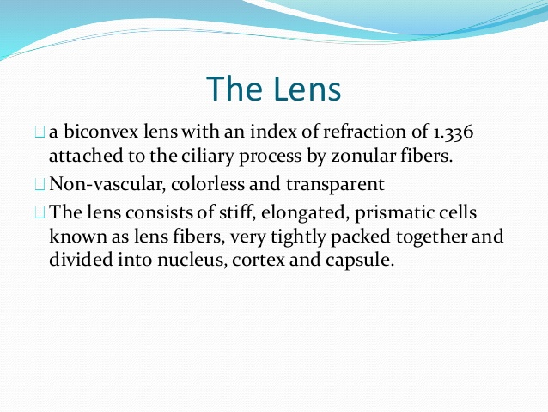

Slide 13
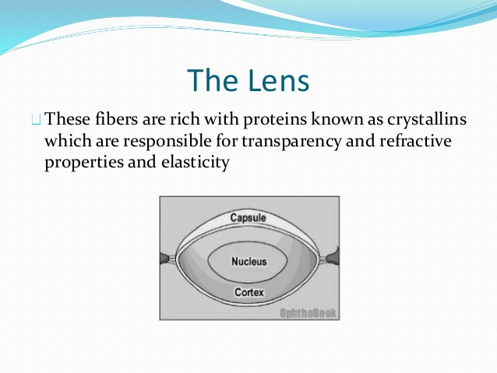

Slide 14
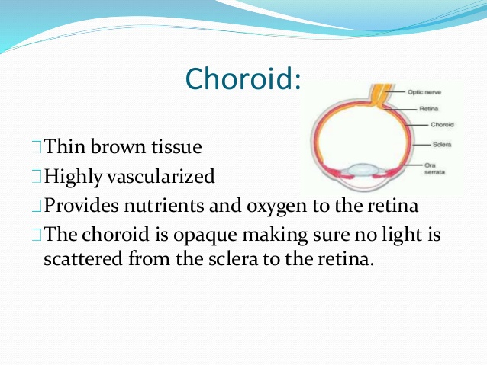

Slide 15
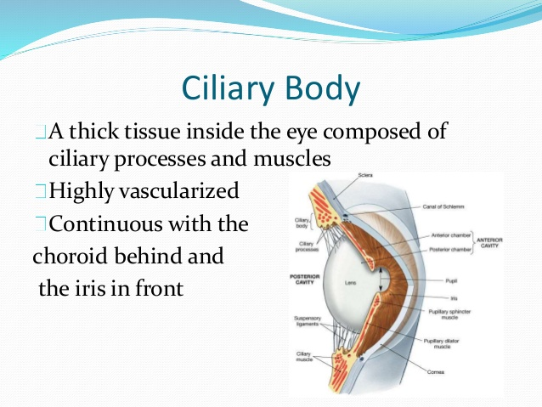

Slide 16
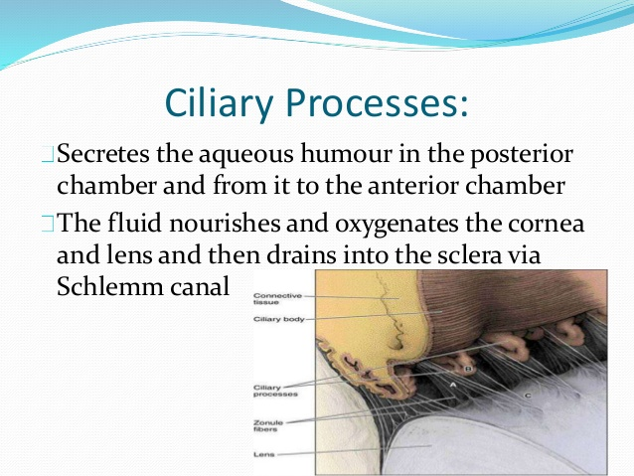

Slide 17
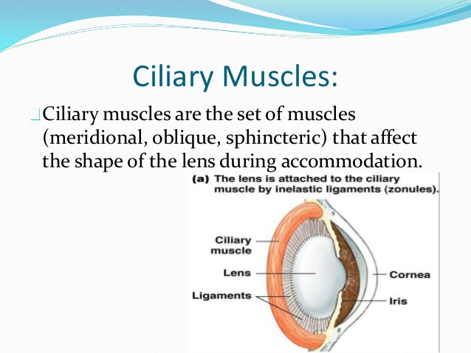

Slide 18
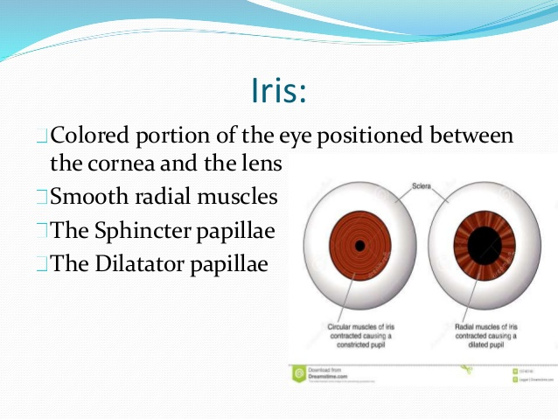

Slide 19
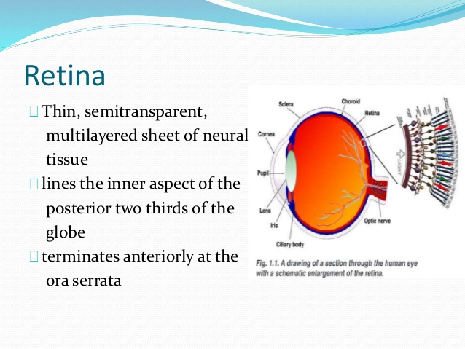

Slide 20
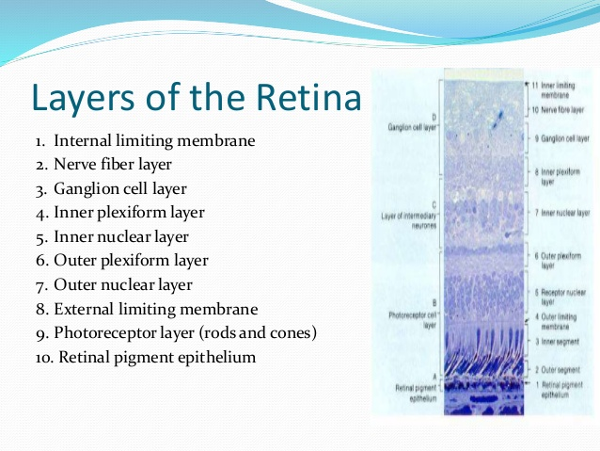

Slide 21
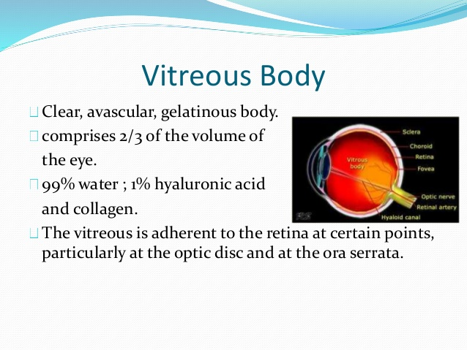

Slide 22
The lens devide the eye into anterior comparment (aquas humour) & posterior compartement(vitrous humour).
The iris devide the ant. Compartement into anterior & posterior chambres.

Slide 23
The aquas humour
Alkaline clear fluid fill ant. & post. Chambers
High O2 tention ,contain hcl & HCO3.
Mechanism of formation.
Drainage of aquas.

Slide 24
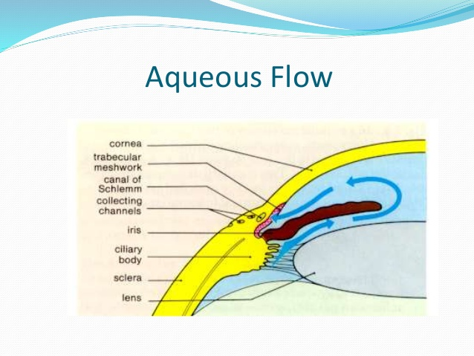

Slide 25
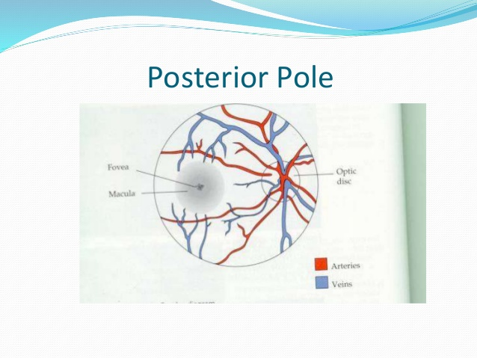

Slide 26
The IOP
THE PRESSURE INSIDE THE BALL
Normally 12-19 mmhg.
Shows duirnal variation? Highest in morning & lowest in evening.
Regulation : by controlling aquas out flow.
Importance:
1- maintain shape of eye ball 2-normal focusing mechanism of eye.

Slide 27
Measurement of IOP
BY TONOMETER.
Types:
Indentation tonomer
Applantation tonometer.
Steps of tonometery????

Slide 28
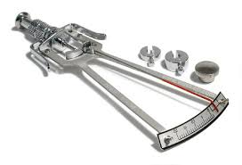
Indentation tonometer

Slide 29
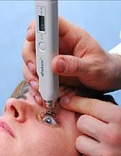
Applantation tonometer

Slide 30
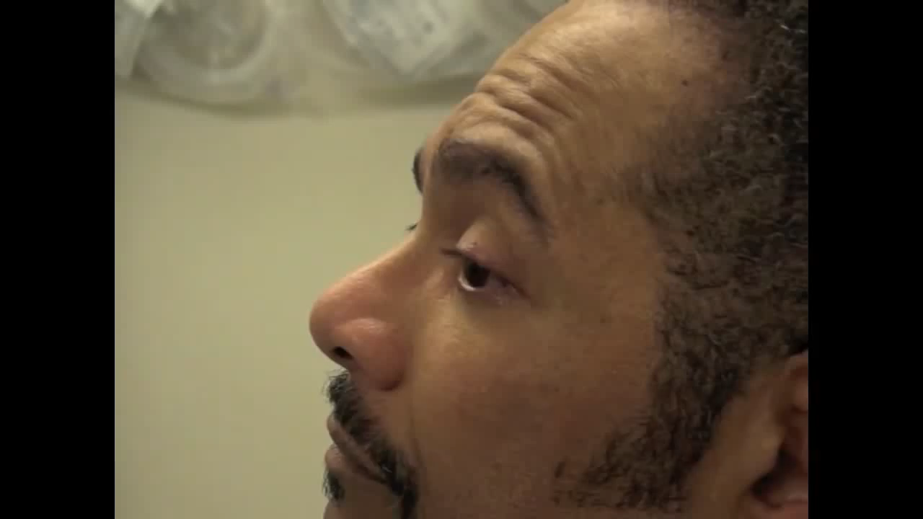

Slide 31
glucoma
Def: Group of eye deseases share a common trait of increased IOP up to 60-70 mmhg, optic disc damage & gradual diminution of vision
Causes: impaired out flow of aquas.
Types: 1- open angle glucoma
2- closed angle glucoma
3- normal tention glucoma

Slide 32
Effects of glucoma
sever eye pain
headach
mydriasis
failure of accommodation
dimminution of vision
cupping of optic disc
visual field deffects & blindness

Slide 33
Treatment of glucoma
paraSympathomimetics (miotics) as eserine or pilocarbine → miosis →open spaces of fontana.
Carbonic anhydrase inhibitors as diamox → decrease aquas formation
Surgery: teriphine or hole at irridoconeal angle.

